Slide 1
Face Mask Detection using Convolutional Neural Networks -by praveena
.

Slide 2
Abstract…
Project is about building a Face Mask Detector using Convolutional Neural Networks (CNN).
This project will detect the dataset which contain faces with and without mask on their faces.
Cascade filter is applied to the image in the dataset to give the region of interest (ROI).
And the ROI image is resized into 100X100 and passed into pretrain CNN and will get the output of the probabilities of face with mask and without mask.
Goal is to train a custom deep learning model to detect whether a person is or is not wearing a mask.

Slide 3
Introduction
COVID-19 is a highly contagious disease, and the WHO and other health agencies have recommended that people use face masks to prevent its transmission.
All governments are attempting to guarantee that face masks are worn in public places, but it is difficult to manually identify those who are not wearing face masks in crowded places. Scientists are working on developing automatic methods to identify and enforce the use of face masks in public locations.
This project work aims to a develop technique that can accurately detect mask over the face in public areas.

Slide 4
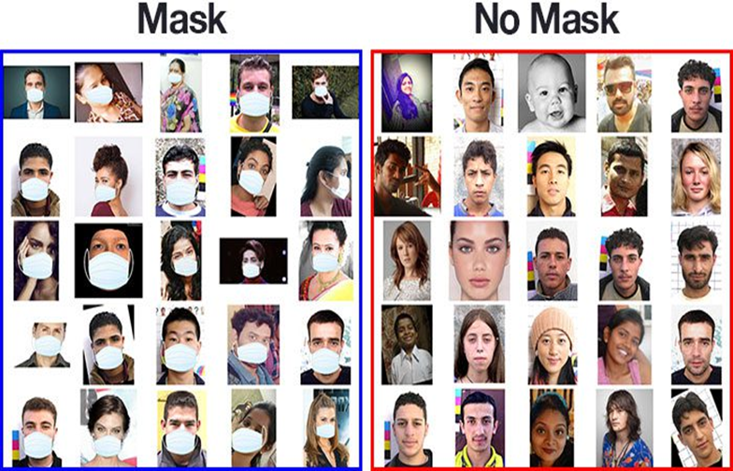
This dataset consists of 1,376 images belonging to two classes:
1.with mask:690 images
2.without mask:686 images

Slide 5
.
In order to train a face mask detector, we need to break the project into two distinct phases, each with its own respective sub-steps:
Training: Here we’ll focus on loading our face mask detection dataset from disk, training a model (using Keras/TensorFlow) on this dataset, and then serializing the face mask detector to disk
Deployment: Once the face mask detector is trained, we can then move on to loading the mask detector, performing face detection, and then classifying each face as with mask or without mask.

Slide 6
Libraries Used
OpenCv
Keras
Numpy
Sklearn
Matplotlib

Slide 7
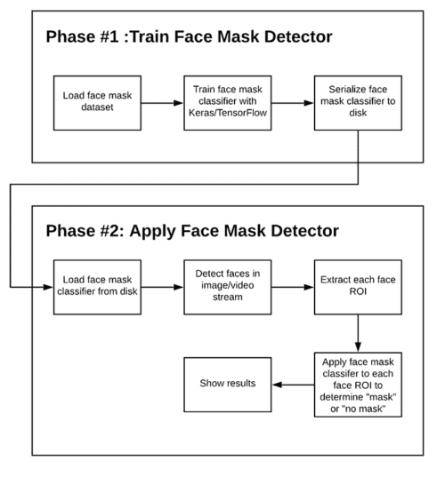
two-phase face mask detector

Slide 8
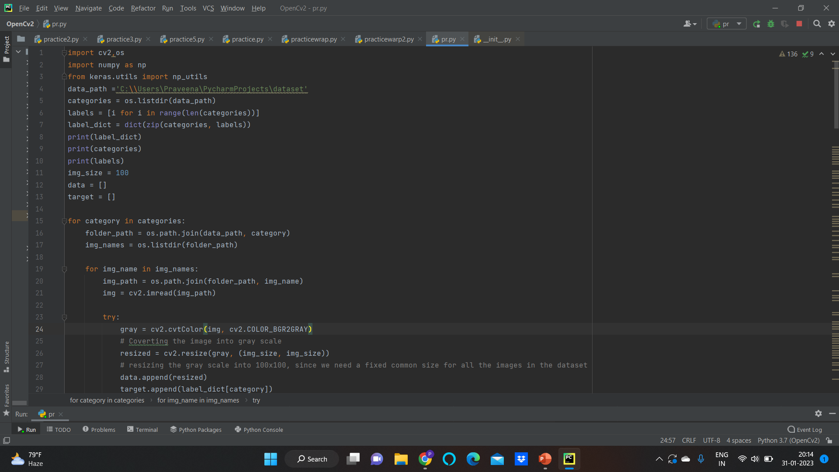

Slide 9
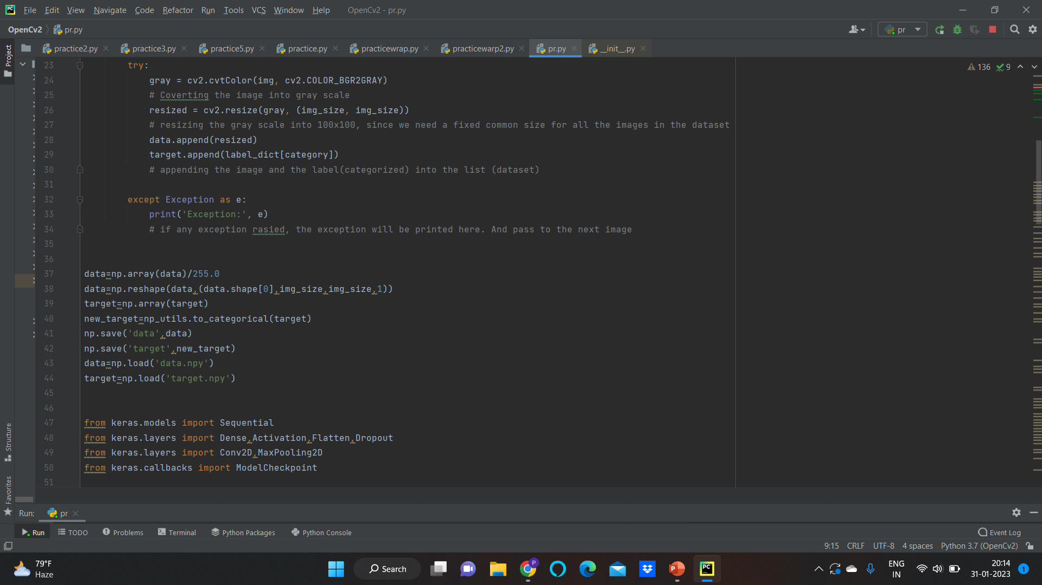

Slide 10
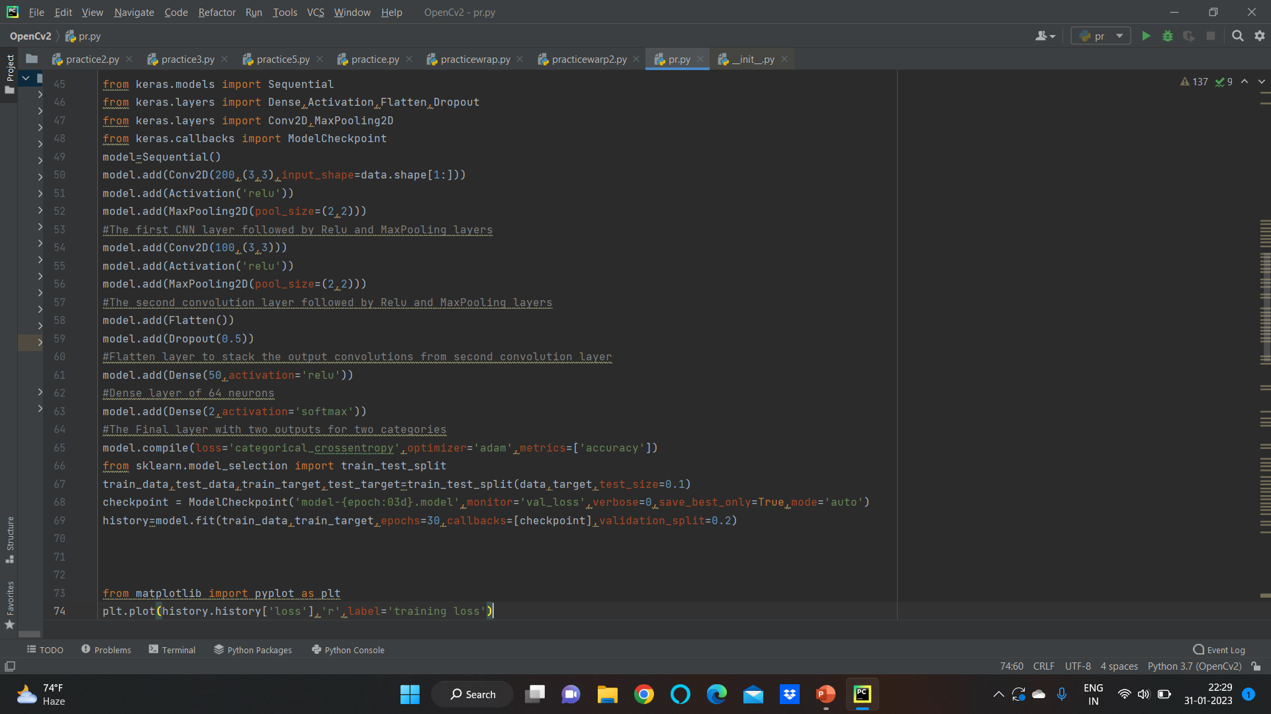

Slide 11
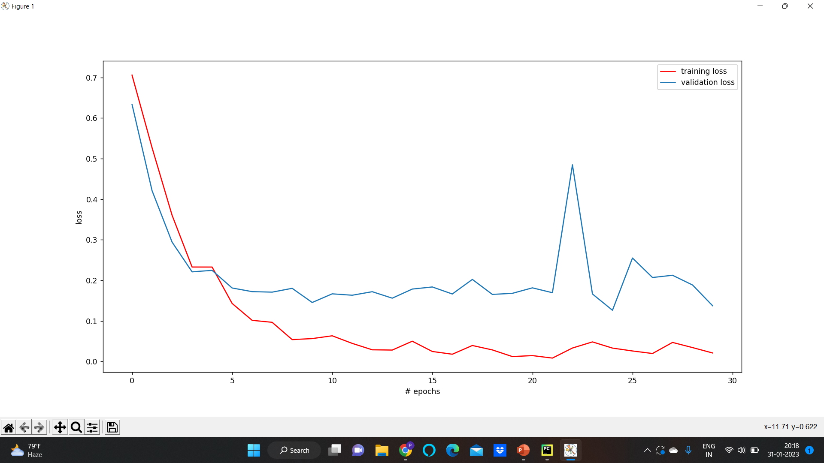

Slide 12
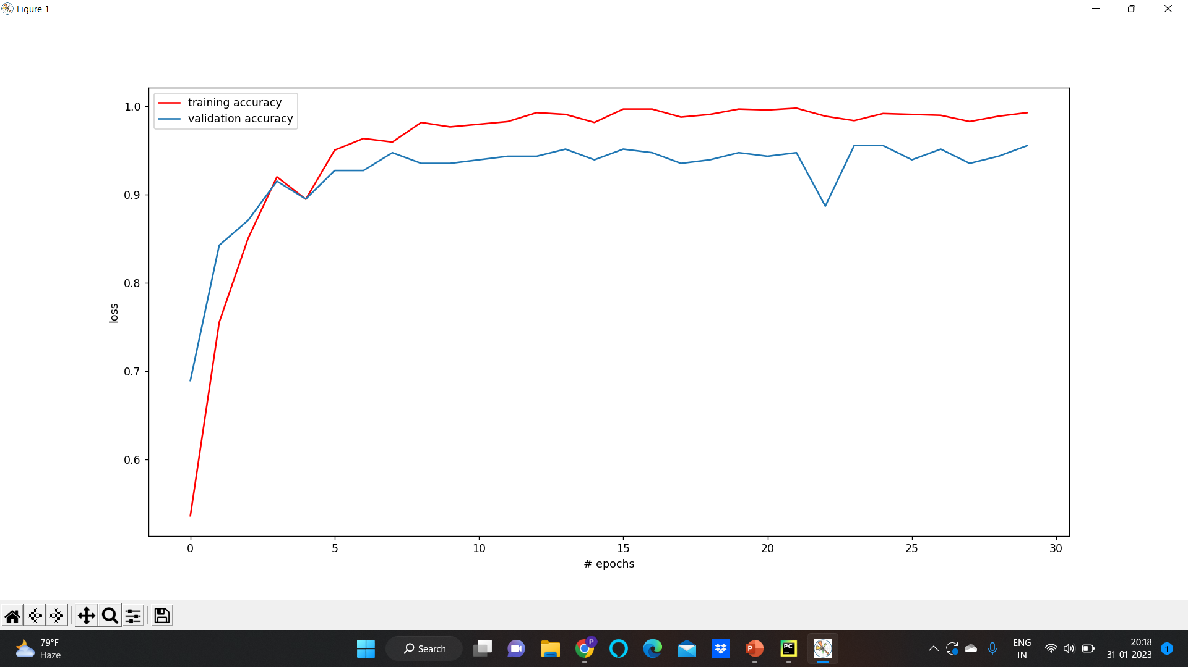

Slide 13
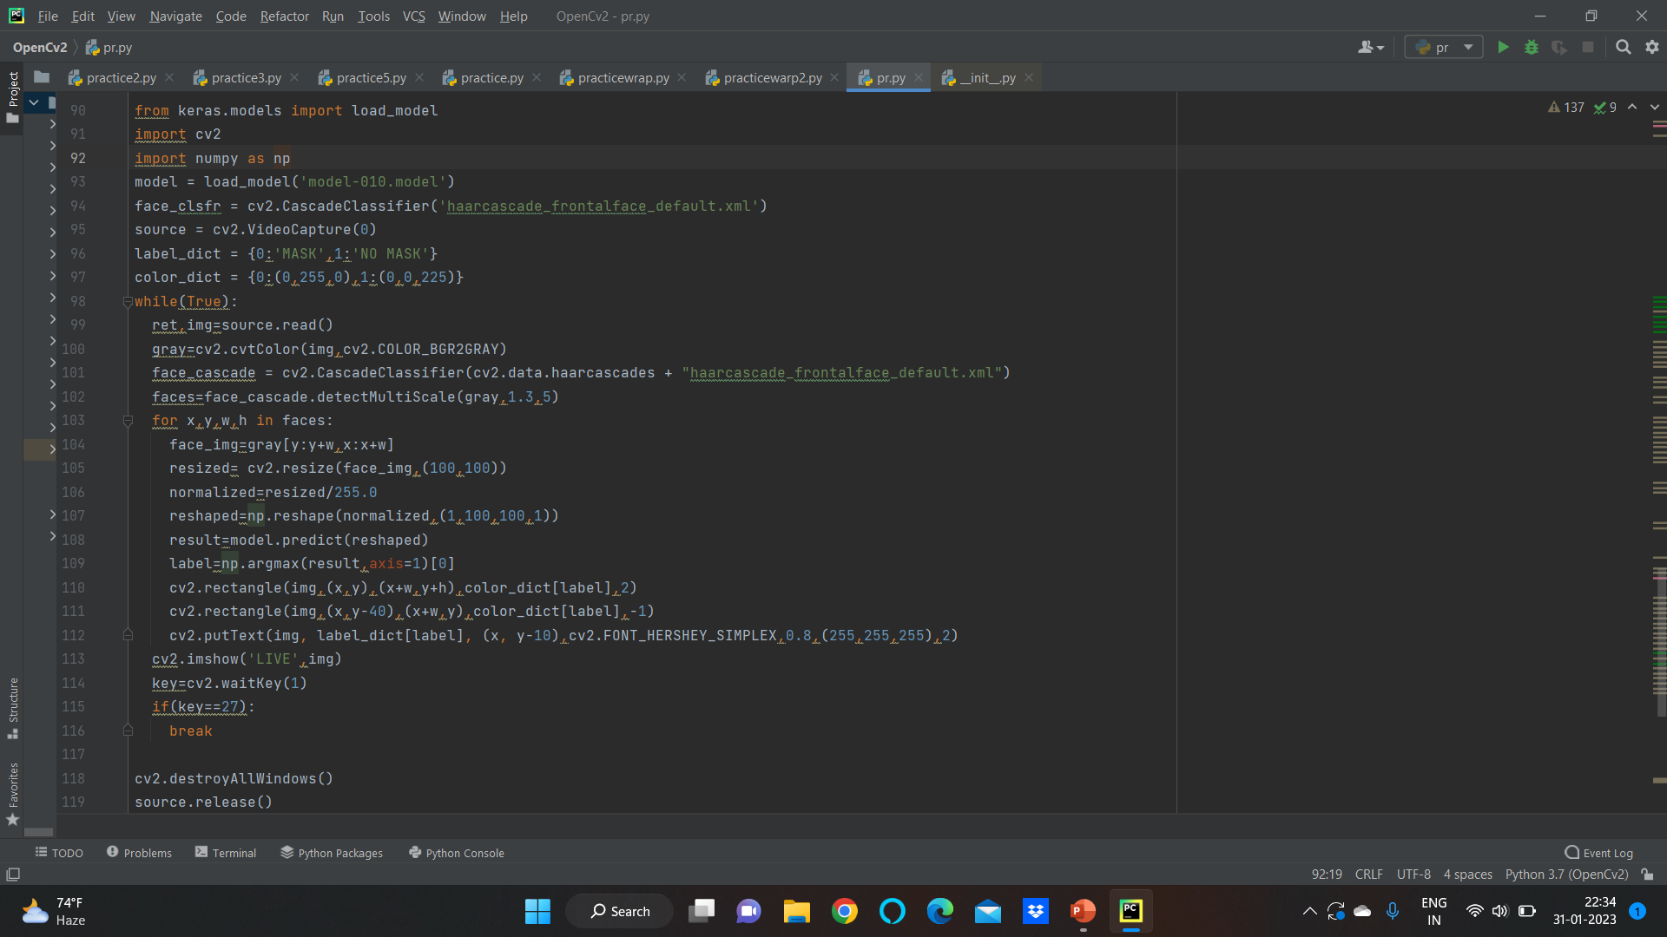

Slide 14
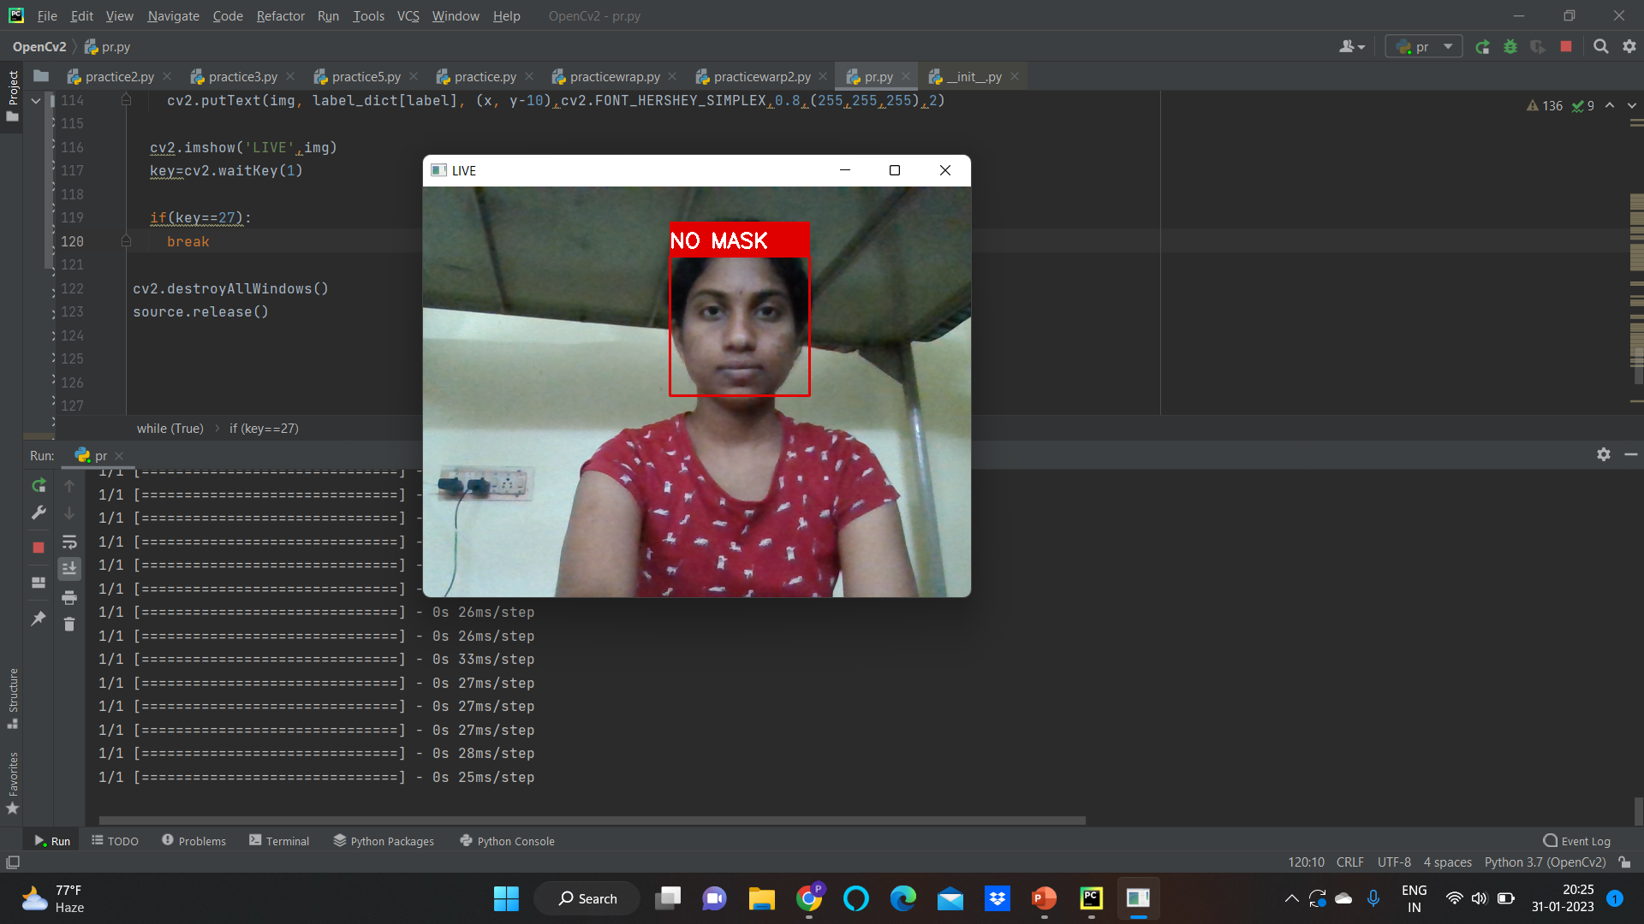

Slide 15
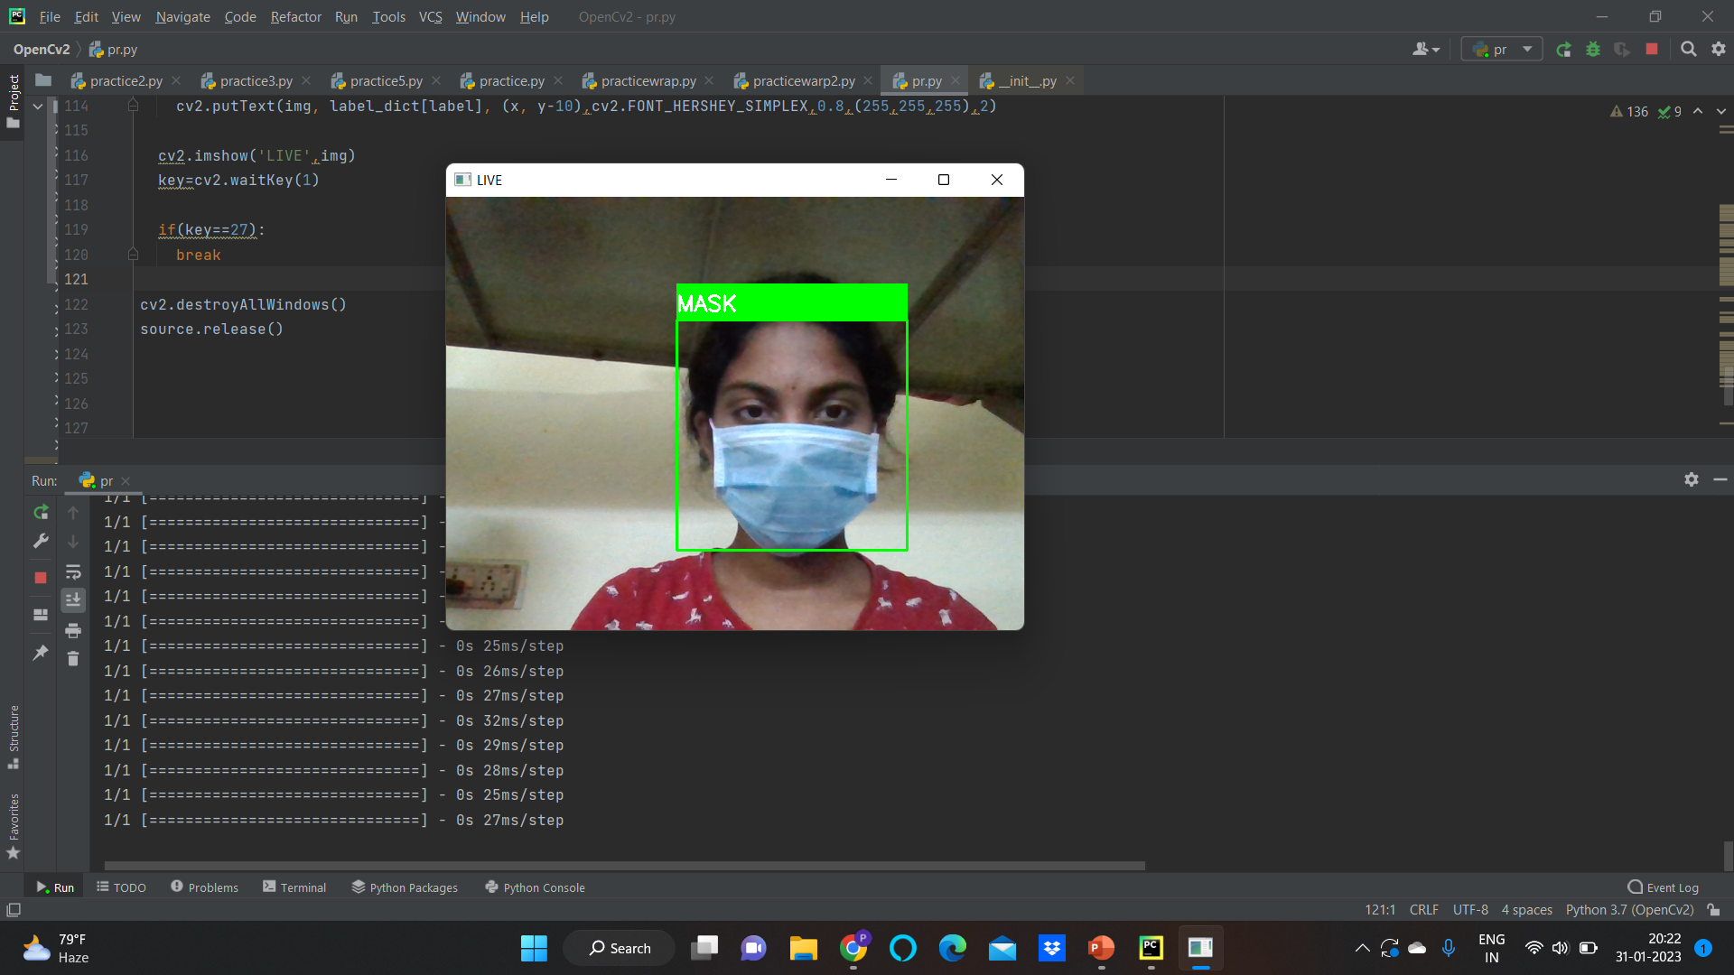

Slide 16
.
Thank you

